Slide 1
Using Big Data Techniques for Analysis & Prediction of Flight Delay & Cancellation

Slide 2
Project Description
Goal: To analyze historical airline data from the years 2009 – 2018 to build a prediction model to predict the possible chance of delay and cancellation.
Input Data: Kaggle Dataset (Flight Information of US domestic flights.)
Input Data Specifications: The raw data is in the form of CSV files classified based on years corresponding to the data. The total size of the data is 7.62 GB.
Output: Perform EDA, generate visualizations, and build prediction models based on the principles of Big Data.

Slide 3








Implementation of Architecture.
Visualizations
Storage
Processing
Input Data Source
Prediction Models
Spark MLLib

Slide 4
Modifications from defense and report
We were able to execute and develop the model as initially proposed in the defense.
Along the way, we faced obstacles, but were able to tackle them and achieve the intended target.
After processing the massive amount of data, we were able to generate very interesting insights about airlines, various airports.
We analysed how the impact of delay varies with respect to the month, week, day, slot and specifically upto the hour.
We were able to train and build complex machine learning models with multiple features to build a prediction model for delay and cancellation.

Slide 5
Understanding the Data
The data is basically divided into 10 CSV files, each file represents 1 year’s flight data. The combined size of the data is 7.62 GB.
On an average, each CSV file is has about 6 million rows of data, that brings the total instances/rows of data to over 60 million.
The data consists of 27 columns of data, that includes both continuous and categorical variables.
Some of the key features identified include - flight_date, carrier, origin, destination, distance, departure_time, Arrival_delay.
Other features include - cancellation_code, carrier_delay, weather_delay, NAS_delay, security_delay.

Slide 6
Processing of Data - Using PySpark
After loading the data from MongoDB, most of the columns data and respective data types were improperly formatted as string type.
In the cleaning phase and pre-processing of data, we modified the data types based on the requirement.
Type_casted the fields such as date, delay, take_off, planned_times data into time_stamps.
After conversion of the data into the time() format, we generated more categorical data from the continuous time data. (Month, day of week, slot of day, arrival time in - minutes, delay in minutes)
This step will eventualy help us in building an effective ML model for prediction.

Slide 7
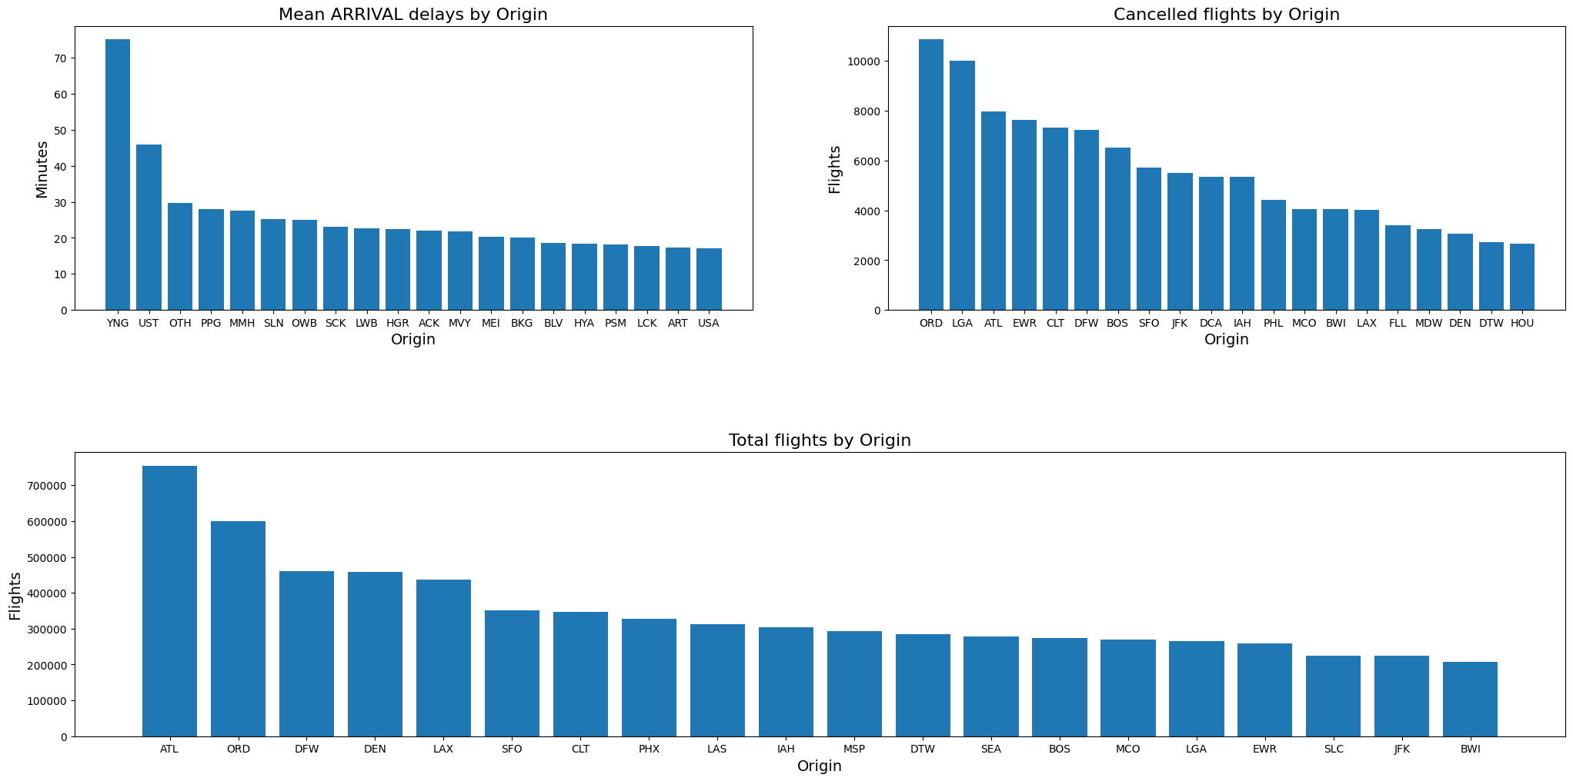
Insights and Visualisations Delay and cancellations by Origin

Slide 8
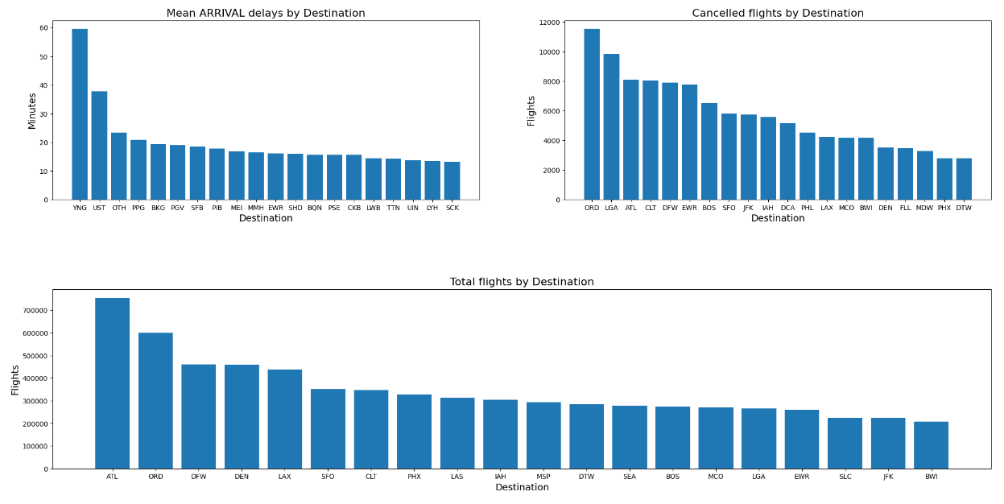
Insights and Visualisations Delay and cancellations by destination

Slide 9
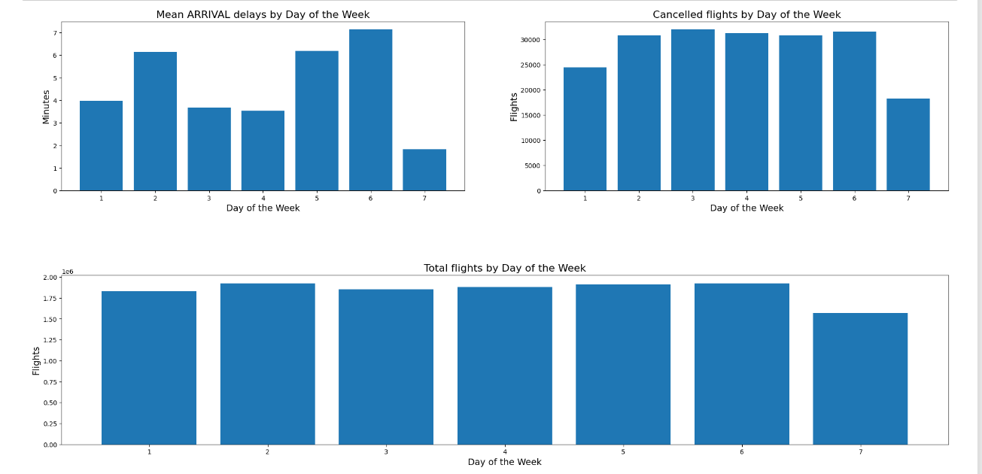
Insights and Visualisations – Variation in delay and cancelation As a function of “Day of the week”

Slide 10
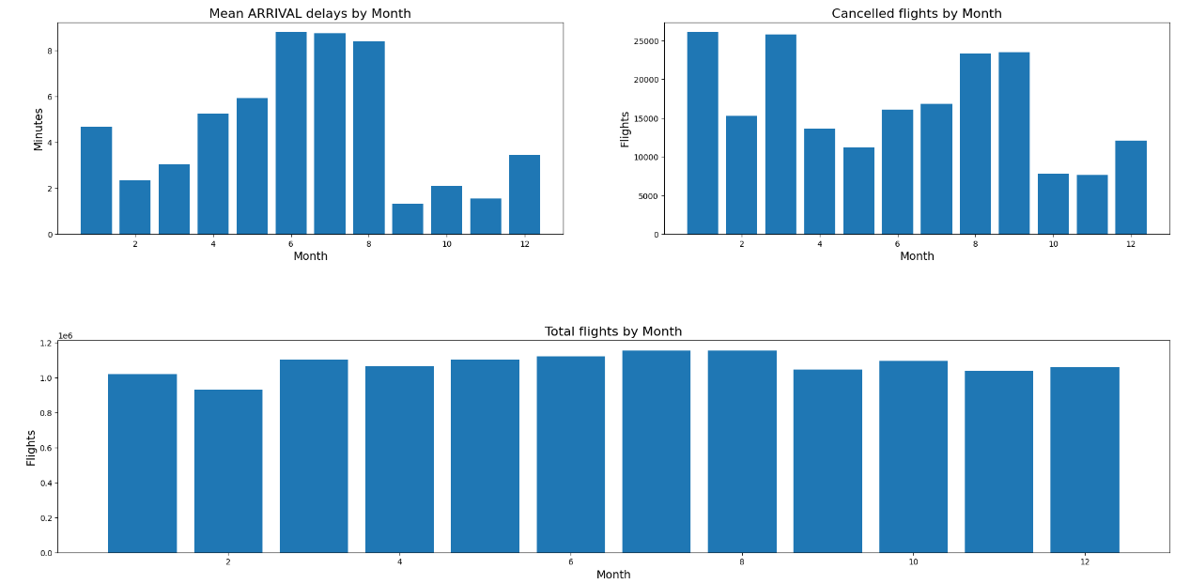
Insights and Visualisations Delays and Cancellations by Month

Slide 11
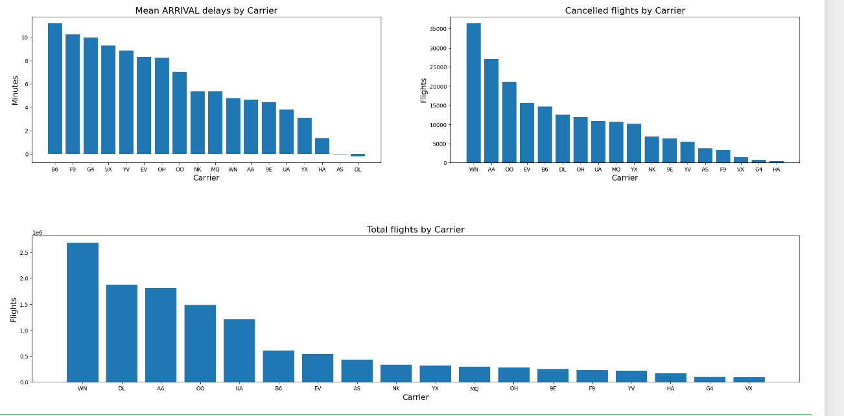
Insights and Visualisations Which are the most reliable and unreliable Airlines ?

Slide 12
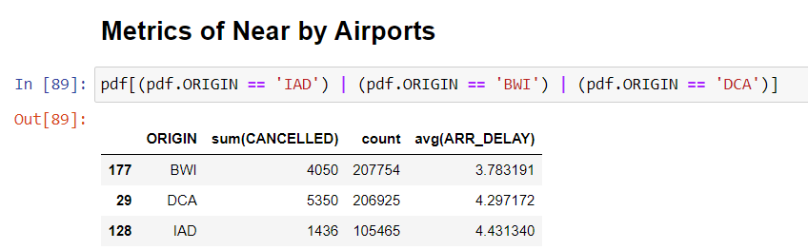
Insights and Visualisations So DMV residents, For domestic travel which is the best airport for us to pick amongst BWI, DCA and IAD ?
The mean arrival delay, when IAD/BWI and DCA are Origin is very similar.
But, 25% of the flights scheduled from DCA were cancelled.
Around 20% of those planned from BWI were also cancelled.
Though IAD has the least number of domestic flights scheduled, It had a cancellation rate of just 14%. Much lower than the other two airports !

Slide 13
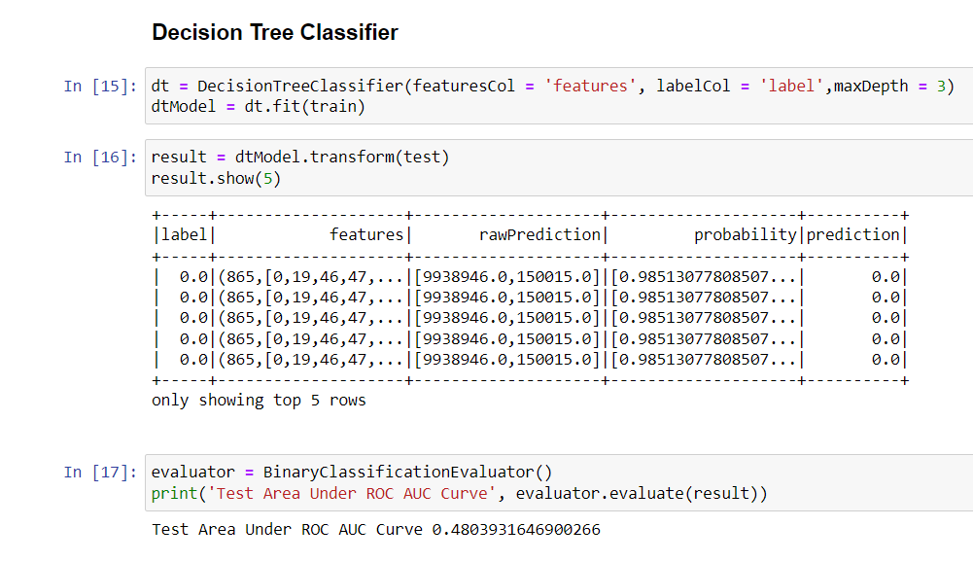
Machine Learning Model -1 Prediction of Cancellation
Algorithm used: DecisionTree Classifier.
Features: date, carrier, origin, hour_of_day, destination, month, day, week.

Slide 14
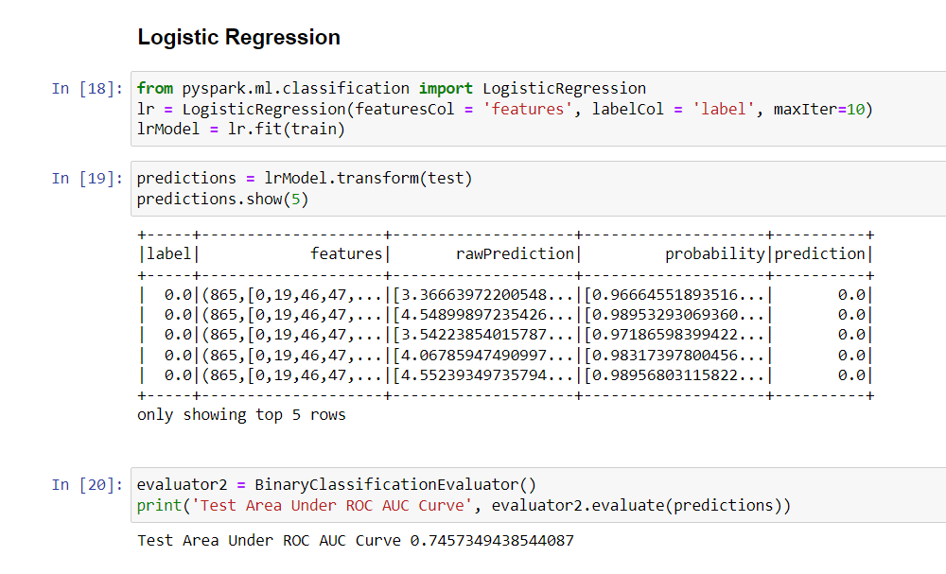
Machine Learning Model -2 Prediction of Cancellation
Algorithm used: Logistic Regression
Features: date, carrier, origin, hour_of_day, destination, month, day, week.

Slide 15
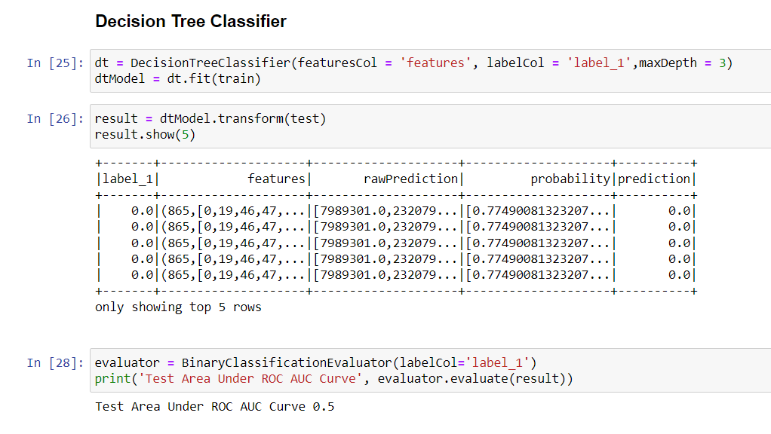
Machine Learning Model -3 Prediction of Delay
Algorithm used: Decision Tree Classifier
Features: date, carrier, origin, hour_of_day, destination, month, day, week.
Target Variable for modelling: Generated column “delay = 0/1”

Slide 16
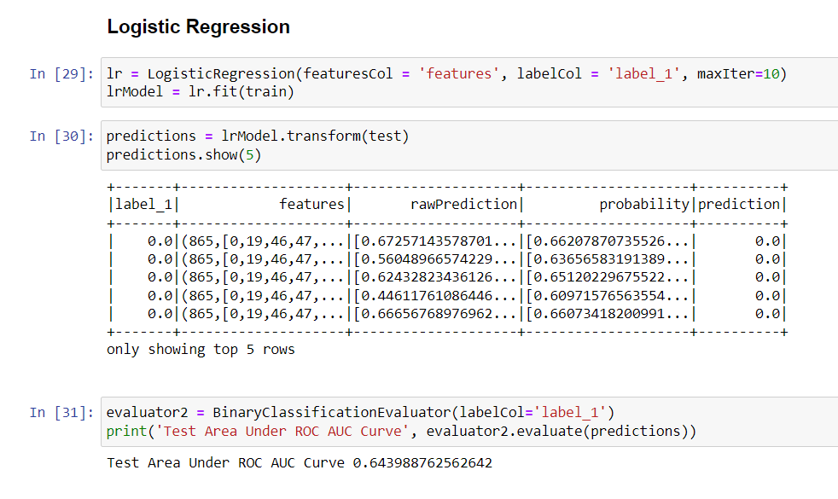
Machine Learning Model -4 Prediction of Delay
Algorithm used: Logistic Regression
Features: date, carrier, origin, hour_of_day, destination, month, day, week.
Target Variable for modelling: Generated column “delay = 0/1”

Slide 17
Analysis of Machine Learning Models Performance.
Why logistic regression was best perfoming algorithm ?
It is less inclined to overfitting.
No default assumptions about the distribution of the data
Decision tree, is highly variable with small change in data, and considering the magnitude of data, there is high probability for the model to be unstable.
Why the accuracy is not above 90% ?
This is a case of highly unbalanced classification
Apart from features - Many external factors effect the delay of a flight.
One of the main cause for delays/cancellation is weather.
Even without these as features, the models perform well in classifying.

Slide 18
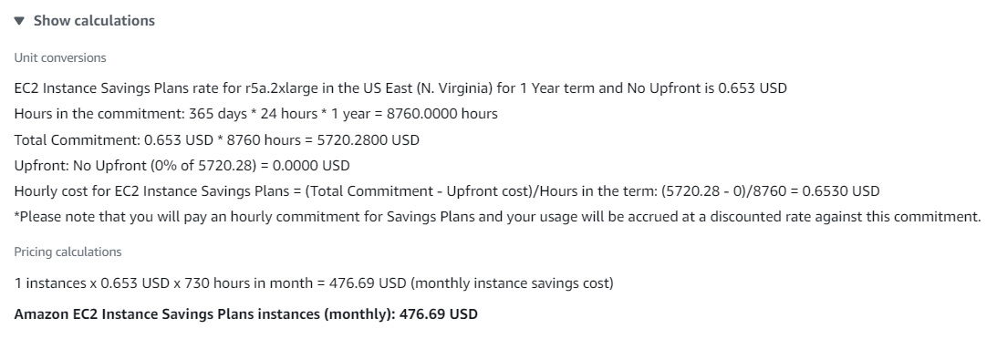
The AWS Problem
How much would it cost for us to deploy an instance of similar hardware from Amazon’s EC-2. ?
4 vCPUs (our hardware 16vCPUs)
40gb RAM
100gb SSD (our hardware 500gb)
for 2 hours useage per day, it would cost 470 USD/Month

Slide 19
Future upgrades - Scope
The data was verified from the original source - US Department of Transportation - Bureau of Transportation Statistics.
However, there is no streaming API for fetching real-time data.
The data has to be manually downloaded as a CSV and the latest data has to be selected.
Therefore, in the future, we would like to further upgrade this project by building and deploying a web spider bot for downloading the latest CSVs and automate the process of fetching the latest data bi-weekly.
Therefore replicating and automating the process of streaming of data.

Slide 20
Conclusion
We were succesfuly able to use the Big Data tools for processing millions of rows of data.
We are able to classify and predict if a flight would be delayed or cancelled, upto an accuracy of 75%.
Gain interesting insights from processing the data, transforming and generating visualizations.
Satisfied most of the criteria for big data 6-V’s:
Value: Nobody likes their flight to be cancelled, great to know beforehand.
Veracity: Authenticiy of data used - verified from original government source.
Volume: Over 60 million rows of data used.
Variability: Variation of data at different phases and time-frames.
Variety: Entire US domestic flights data, wide choice of features available.

Slide 21
Key Takeaways - Learning:
Power of PySpark - Utilization of RAM for super-fast processing.
Clearly understand the difference in performance Spark provides over the alternate tools/frameworks using only Python.
As learnt in class, big data tools, provide the ability to harness the use of commodity hardware for the technologies used.
Specifically, upgrades in personal machine computational capabilities allowing users to run a local setups over cloud or server based setups.
We were able to process, millions of rows of data and also build complex Machine learning models using MLLib and PySpark.
Challenge faced: Required memory bottleneck.

Slide 22
Thank You

